Slide 1

TWEET ANALYSIS USING R LANGUAGE
TWEETS TAKEN OF :
Vladimir Putin, Volodymyr Zelensky, JOE BIDEN

Slide 2
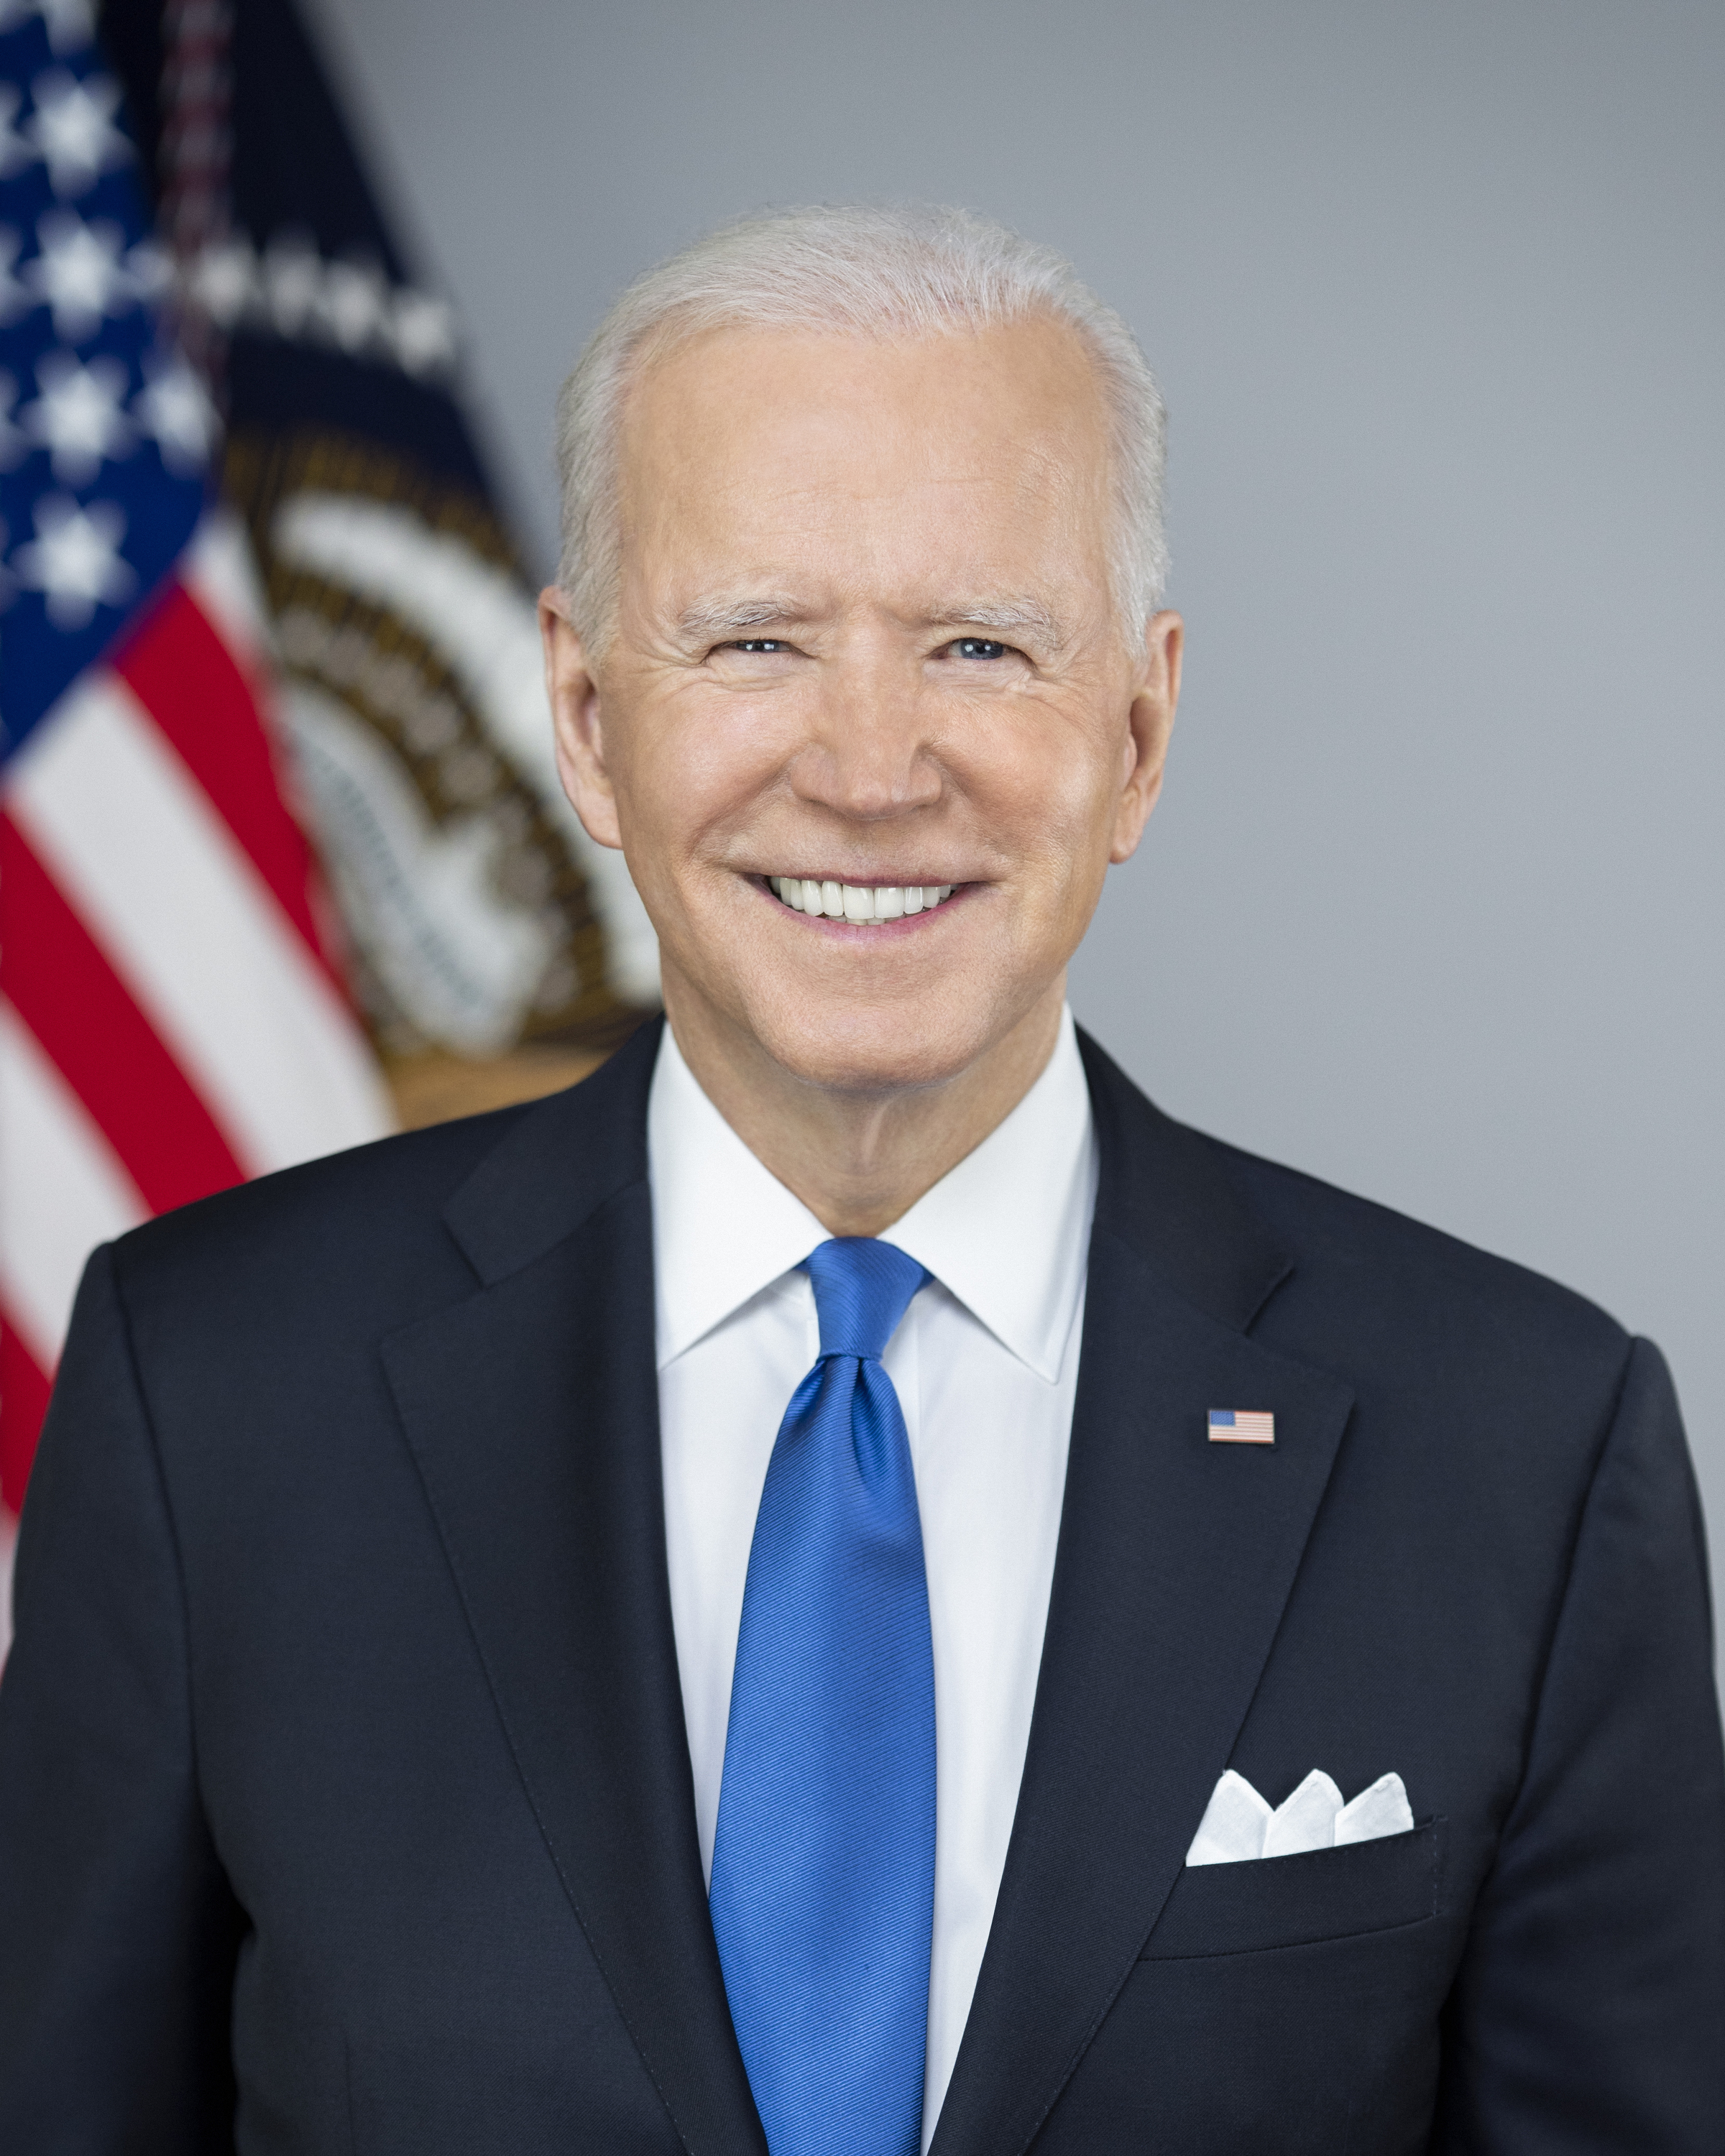
TWEET ANALYSIS OF JOE BIDEN :
Tweets taken from :
24th February 2022 to 12th April 2022
Joe Biden - 46th U.S. President

Slide 3
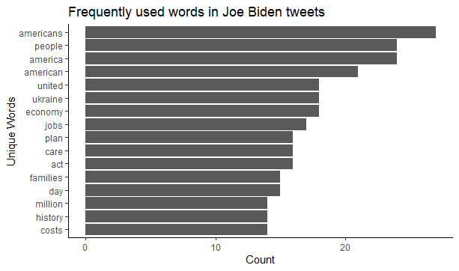
FREQUENTLY USED WORDS FOUND IN JOE BIDEN’S TWEETS :

Slide 4
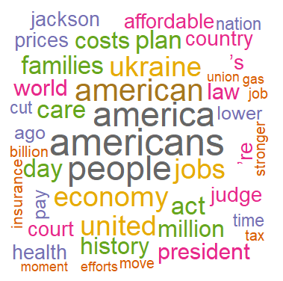
WORLDCLOUD OF JOE BIDEN’S TWEETS :
Joe Biden was more focused on his own country and his people.
It is evident from his tweets that he want people to stand united for the economy of Ukraine.
Biden is planning to create jobs for families who had lost job during the war.
Joe Biden tweets a lot about history of America.

Slide 5
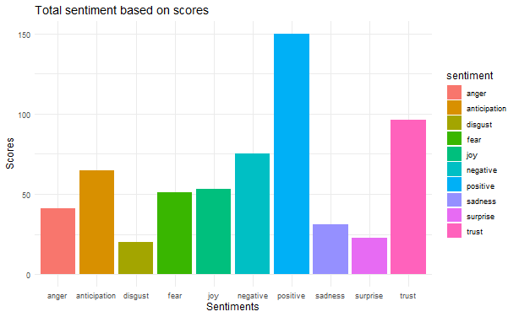
SENTIMENTAL ANALYSIS OF JOE BIDEN’S TWEETS :

Slide 6
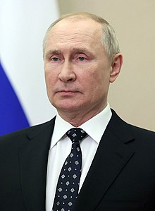
TWEET ANALYSIS OF VLADIMIR PUTIN :
Tweets taken from :
24th February 2022 to 12th April 2022
Vladimir Putin – President of Russia

Slide 7
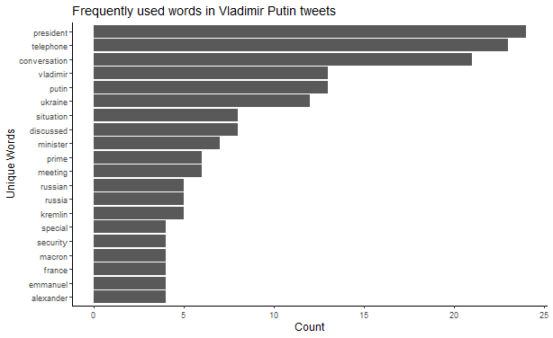
FREQUENTLY USED WORDS FOUND IN VLADIMIR PUTIN’S TWEETS :

Slide 8
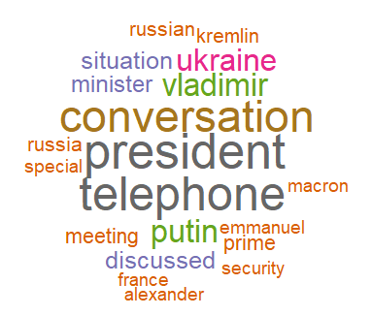
WORDCLOUD OF VLADIMIR PUTIN’S TWEETS :
Putin’s tweets are more about telephonic discussions with president of Russia.
Putin tweets regarding conversation with Emmanuel Macron – president of France.

Slide 9
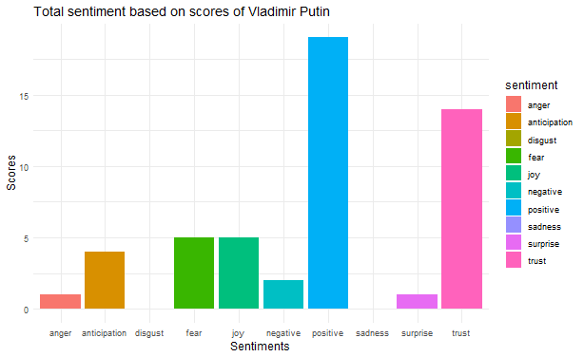
SENTIMENT ANALYSIS OF VLADIMIR PUTIN’S TWEETS :

Slide 10
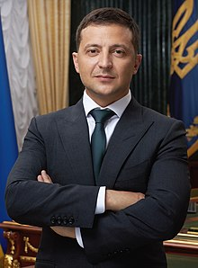
TWEET ANALYSIS OF VOLODYMYR ZELENSKYY :
Tweets taken from :
24th February 2022 to 12th April 2022
Volodymyr Zelenskyy – President of Ukraine

Slide 11
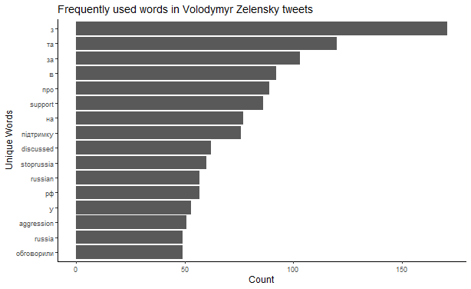
FREQUENTLY USED WORDS FOUND IN VOLODYMYR ZELENSKYY’S TWEETS :

Slide 12
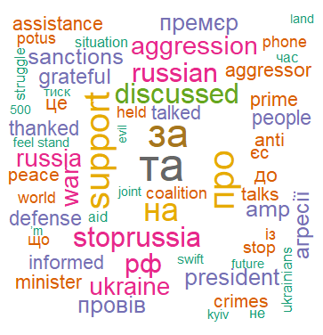
WORLDCLOUD OF VOLODYMYR ZELENSKYY’S TWEETS :
Zelenskyy ‘s tweets are clearly indicating he want the war to end.
Zelenskyy is seeking for peace and support for Ukraine.
His tweets suggest how aggression is spreading in Ukraine and wants Russia to stop. He is indicating this by using the hashtag of stoprussia.
Zelenskyy is also indicating that they are getting assistance from Joe Biden and he thanked, feels grateful for it.
There are lot of crimes happening in Kyiv – the capital of Ukraine.

Slide 13
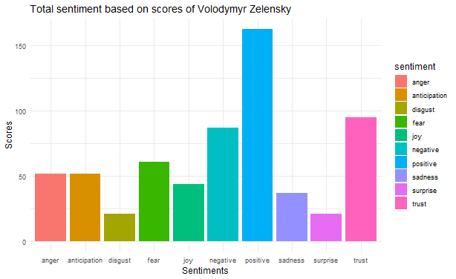
SENTIMENTAL ANALYSIS OF VOLODYMYR ZELENSKYY’S TWEETS :

Slide 14
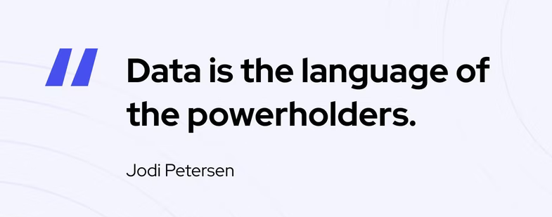
THANK YOUU! HAVE AN AMAZING DAY!

